Slide 1



Exploring the Impact of COVID-19 on Thailand’s Tourism Industry: A Sentiment Analysis Approach using Twitter Data
PRESENTED BY: GUIDED BY:
Nagul K S - 20CSR131 Mr.T.Kumaravel
Naveen A M- 20CSR136
Sakthi Sundaram A - 20CSR178
Department of Computer Science and Engineering

Slide 2
INTRODUCTION
The sentiments and intentions expressed in English-language tweets regarding tourism in Thailand cities.
Predict the sentiments and intentions revealed in these tweets.
To label sentiment and intention classes of tweets related to tourism in the Thai cities.

Slide 3
PROBLEM STATEMENT
The COVID-19 pandemic has severely affected Thailand's tourism sector, which constitutes a significant portion of the country's GDP and export revenue.
Lockdowns, travel bans, and venue closures have led to a substantial decline in revenue, impacting popular tourist destinations.
The evolving tourism landscape, driven by information and communication technology (ICT) and social media, poses challenges to traditional models.
While sentiment analysis with machine learning gains traction, understanding the effects of personalization on customer experience and sentiment remains a research gap.

Slide 4
LITERATURE REVIEW
NAME | ACCURACY | YEAR | PAPER
Mohamed Imran Mohamed Ariff1, Nurul Erina Shuhada Zubir2, Azilawati Azizan1, Samsiah Ahmad1, Noreen Izza Arshad3 | 93.00 | 2024 | Malaysian views on COVID-19 vaccination program: a sentiment analysis study using Twitter
Michał Roman 1,, Arkadiusz Niedziółka 2 and Andrzej Krasnod˛ ebski 2 | 82.78 | 2020 | Respondents’ Involvement in Tourist Activities at the Time of the COVID-19 Pandemic.
Thanapat Sontayasara, Sirawit Jariyapongpaiboon, Arnon Promjun∗, Napat Seelpipat∗, Kumpol Saengtabtim∗,JingTang, and Natt Leelawat | 71.03 | 2020 | Twitter Sentiment Analysis of Bangkok Tourism During COVID-19 Pandemic Using Support Vector Machine Algorithm
ZHAO JIANQIANG1,2,3 and GUI XIAOLIN | 78.03 | 2017 | Comparison Research on Text Pre-processing Methods on Twitter Sentiment Analysis

Slide 5
EXISTING SYSTEM
1.Support Vector Classification (SVC):
Accuracy: Achieved only 70% accuracy for both sentiment and intention analysis. Effective for binary classification tasks.
Disadvantage: Accuracy on the Chiang Mai dataset was below 70% due to a smaller number of training tweets.
CART (Classification and Regression Trees):
Accuracy: Ensemble votes of multiple decision trees in the random forest achieved high accuracy (95.4%) on the Bangkok dataset.
Disadvantage: Achieved the same accuracy on the Chiang Mai dataset as random forest due to its ensemble nature.

Slide 6
Random Forest:
Accuracy: Achieved high accuracy (95.4%) on the Bangkok dataset in the intention analysis.
Disadvantage: The smaller dataset for Chiang Mai reduced the complexity of trees and accuracy.

Slide 7
DISADVANTAGES EXISTING SYSTEM
The algorithms gives the accuracy Challenges with Small Datasets.
Study focused on specific destinations (Bangkok, Chiang Mai, Phuket) and excluded other tourist locations.
Limited to English-language tweets, potentially missing sentiments expressed in other languages.

Slide 8
PROPOSED SYSTEM
Machine learning models, including XGBClassifier, DecisionTreeClassifier and LogisticRegression to analyze sentiment and perceptions in the Thai tourism sector post-COVID-19. Leveraging these models, to predict and understand the evolving traveler sentiments based on social media data.
XGBClassifier's boosting capabilities, DecisionTreeClassifier's interpretability and Logistic Regression's simplicity will be utilized to identify trends, preferences, and sentiment shifts.
To provide insights into developing effective strategies for the recovery and sustainable growth of Thailand's tourism industry amid changing travel behaviors and economic challenges.

Slide 9
ALGORITHM
Logistic Regression
Decision Tree Classifier
XGB Classifier

Slide 10
MODULES OF THE PROJECT
Preprocessing
Feature Extraction
Training
Testing
Accuracy Analysis

Slide 11
Accuracy and F1-score
Algorithm | Accuracy | F1-score
Logistic Regression | 0.98 | 0.59
Decision Tree Classifier | 0.99 | 0.53
XGB Classifier | 0.96 | 0.49

Slide 12
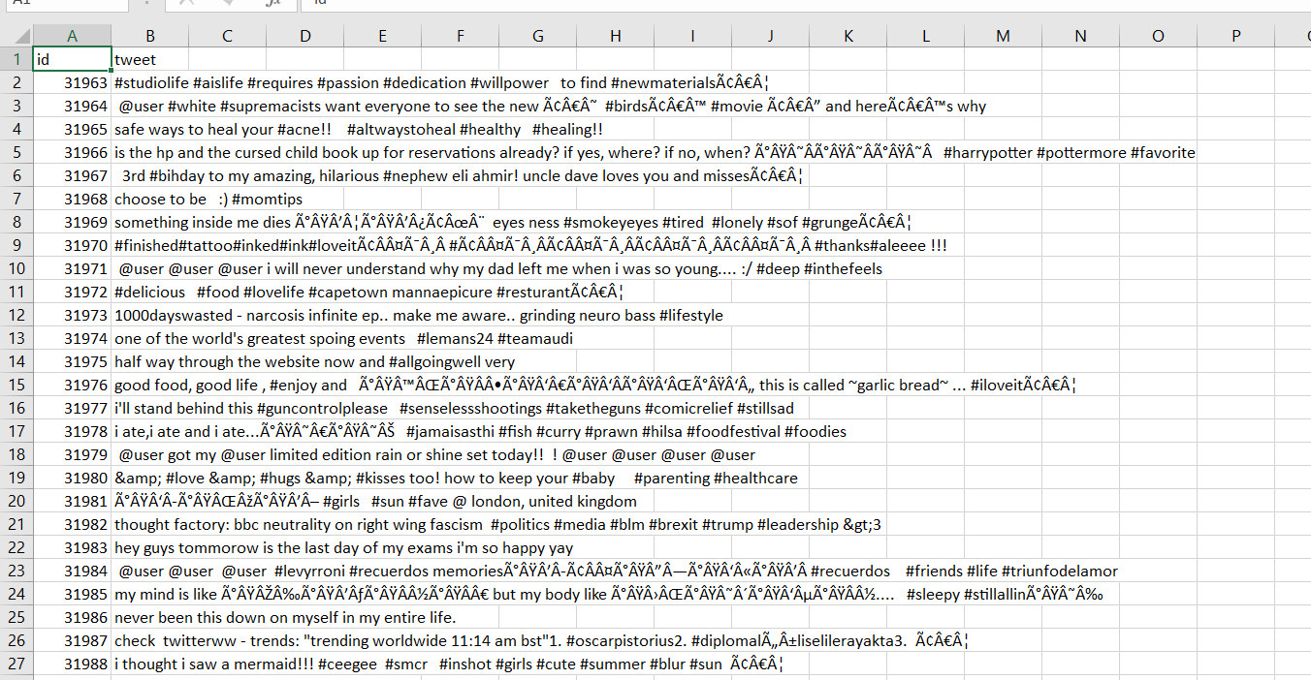
DATASET

Slide 13
THANK YOU!.......

